Slide 1

APEX INSTITUTE OF TECHNOLOGY
DEPARTMENT OF COMPUTER SCIENCE & ENGINEERING
Computer Organization & Architecture (21CSH-281)
Faculty: Siddharth Kumar (E12853)
Lecture - 10
Computer Arithmetic: Integer Addition and Subtraction
DISCOVER . LEARN . EMPOWER

Slide 2
Computer Organization & Architecture: Course Objectives
COURSE OBJECTIVES
The course aims to:
The purpose of the course is to introduce principles of computer organization and the basic architectural concepts.
It begins with basic organization, design, and programming of a simple digital computer and introduces simple register transfer language to specify various computer operations.
Topics include computer arithmetic, instruction set design, microprogrammed control unit, pipelining and vector processing, memory organization and I/O systems, and multiprocessors.
To familiarize Students with the detailed Architectures of a Central Processing Unit.
Learn the different types of serial communication techniques.

Slide 3
COURSE OUTCOMES
On completion of this course, the students shall be able to:-
CO1 | Identify and interpret the basics of instruction sets and their impact on the design, organization, and functionality of various functional units of a computer comparable to the CPU, memory organization, I/O organization, and parallel processors.
CO2 | Analysis of the design of arithmetic & logic unit and understanding of the fixed point and floating-point arithmetic operations.
CO3 | Relate cost performance and design trade-offs in designing and constructing a computer processor which includes memory.
CO4 | Understanding the different ways of communicating with I/O devices and standard I/O interfaces.
CO5 | Implementation of control unit techniques and the concept of Pipelining.

Slide 4
Arithmetic & Logical Unit
Data Manipulation
Arithmetic Operations
Logical Operations

Slide 5
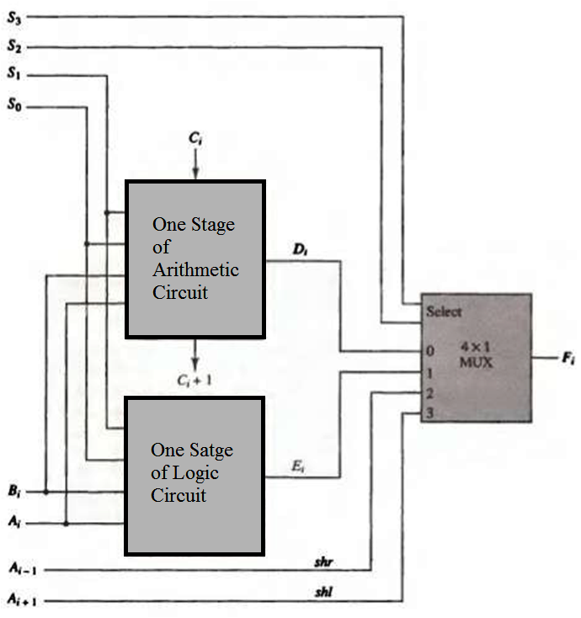
Block Diagram of Basic ALU

Slide 6
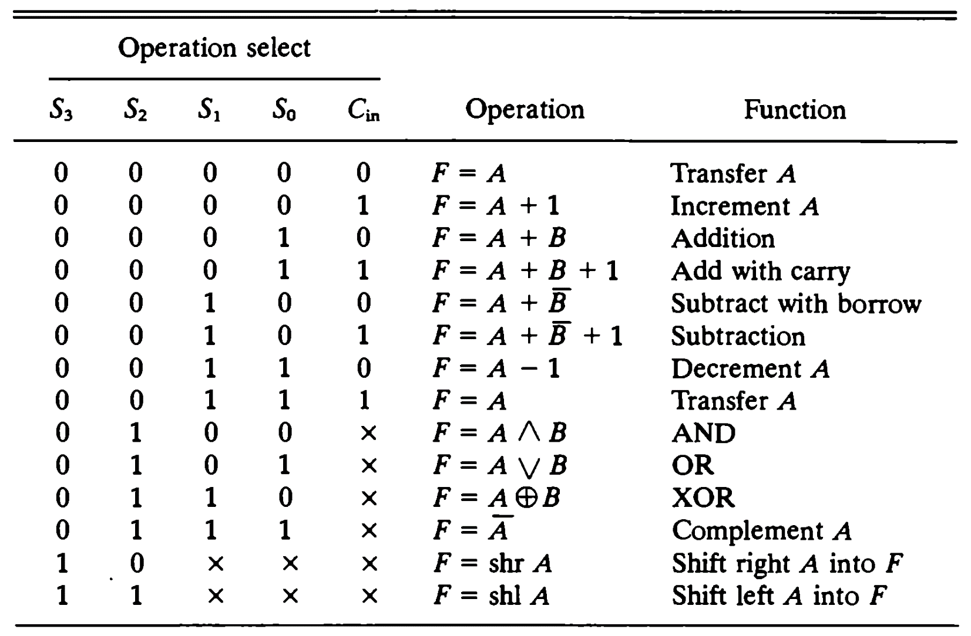
Functional Table of ALU

Slide 7
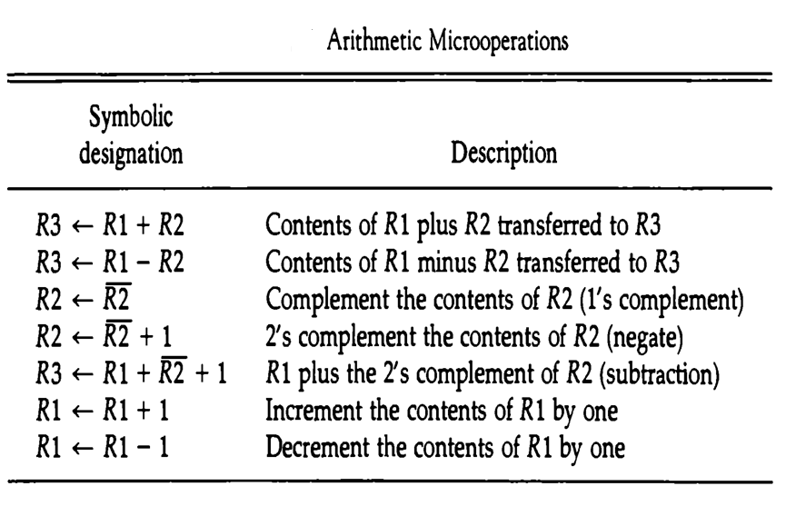
Arithmetic Operations

Slide 8
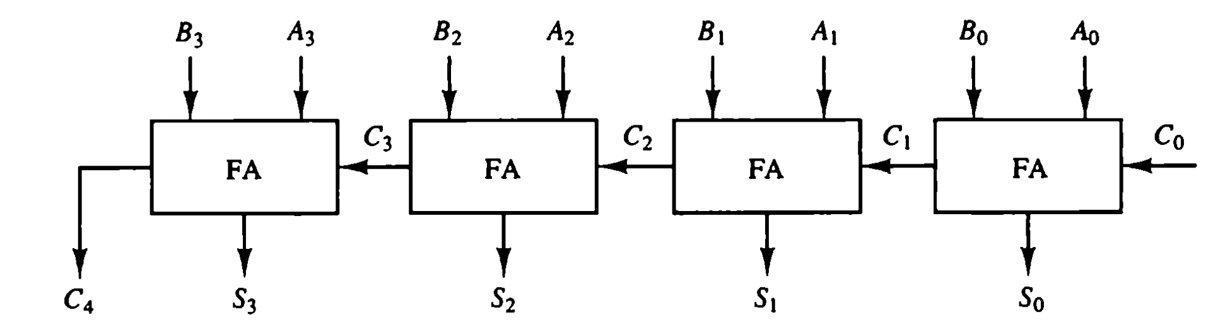
An Example of ALU Component: 4 – bit Binary Adder

Slide 9
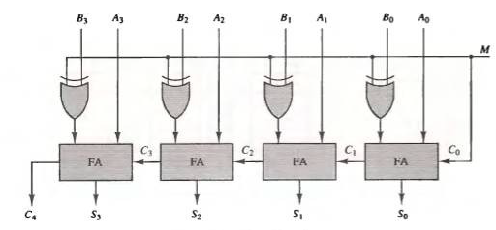
4 – bit Binary Adder - Subtractor

Slide 10
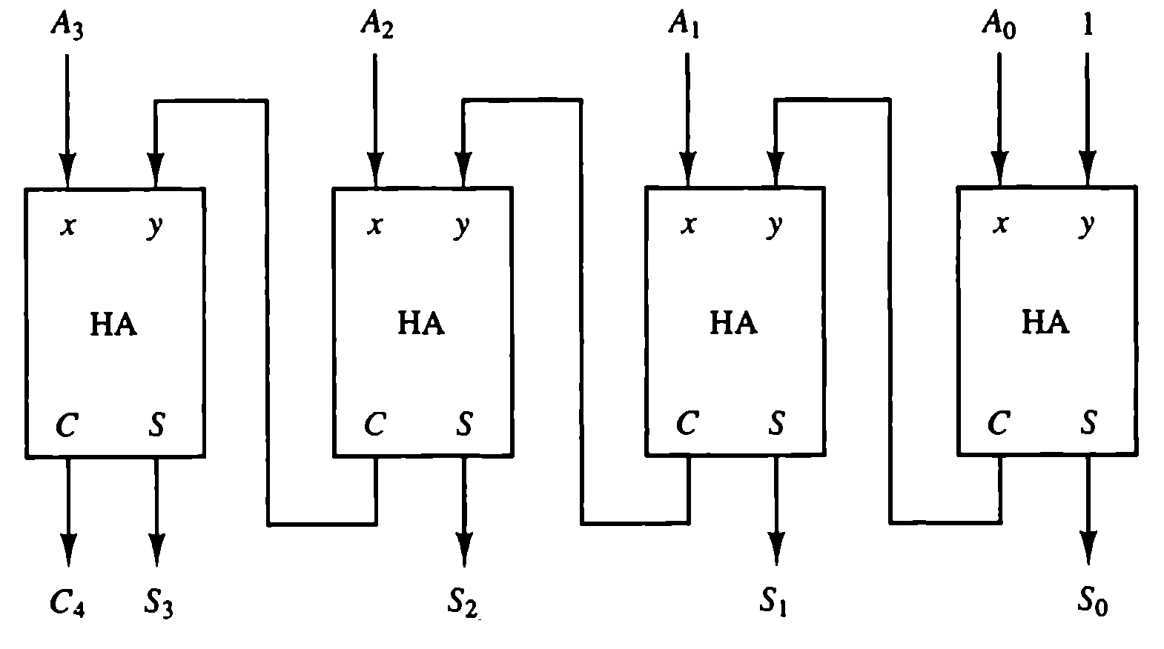
Binary 4 – bit Incrementor

Slide 11
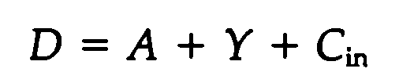
4 – bit Arithmetic Circuit

Slide 12
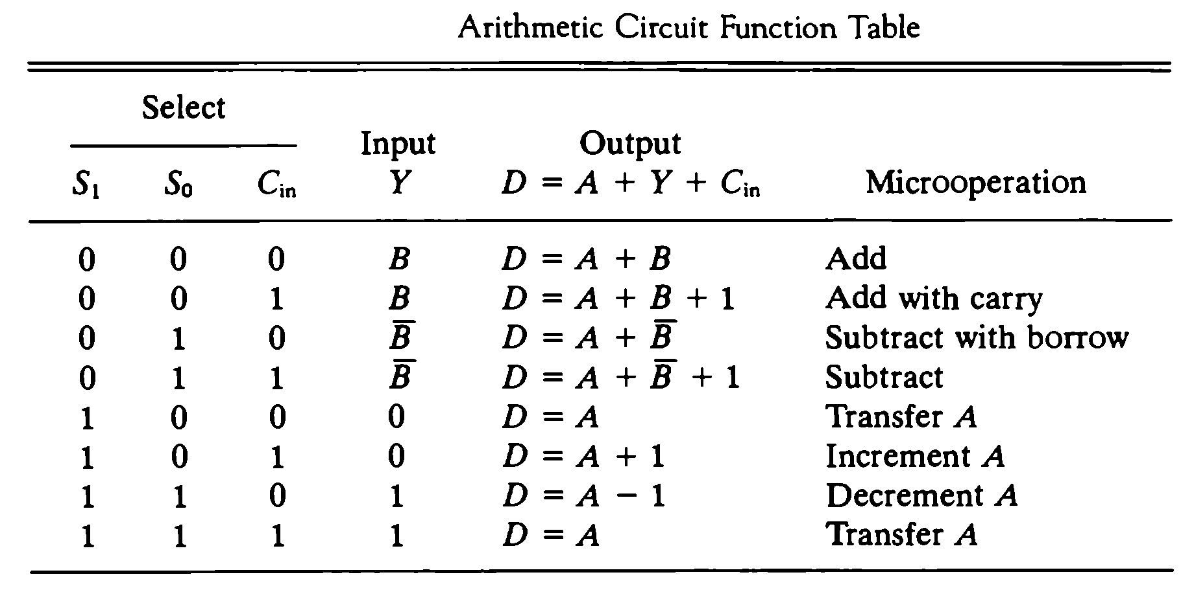
4 – bit Arithmetic Circuit

Slide 13
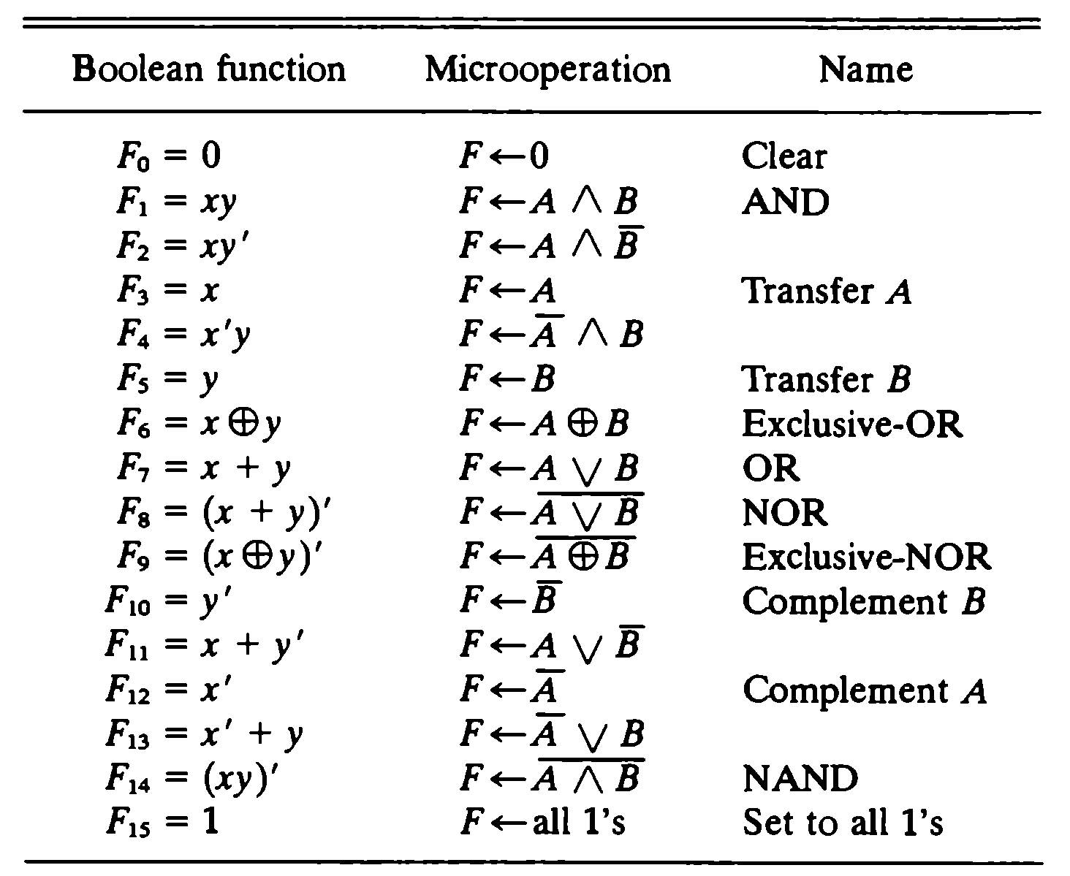
Logical Operations

Slide 14
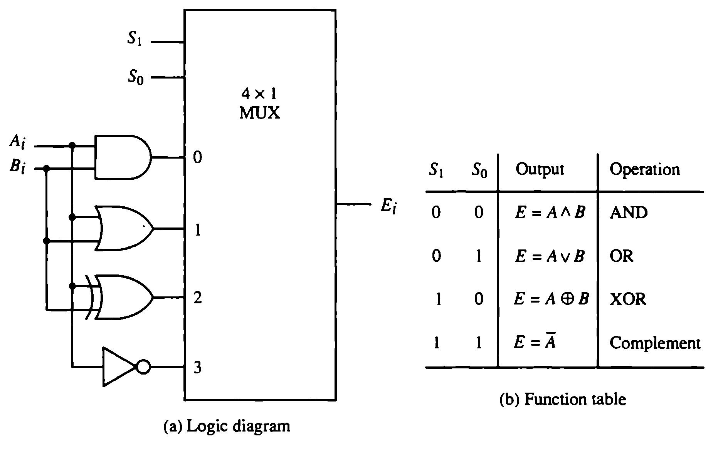

Slide 15
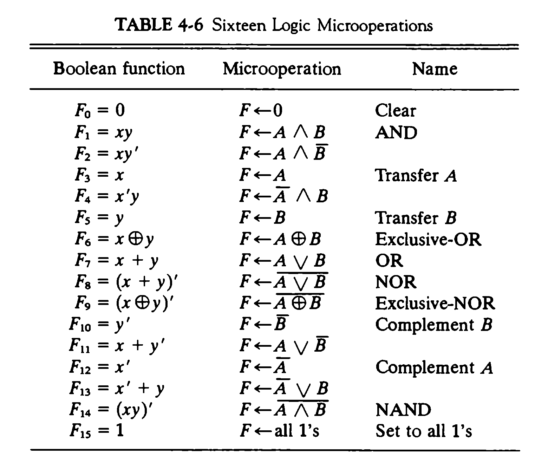
Pre-requirements
Logical Microoperations

Slide 16
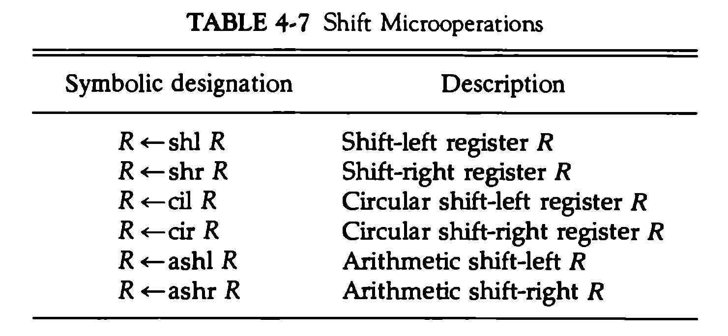
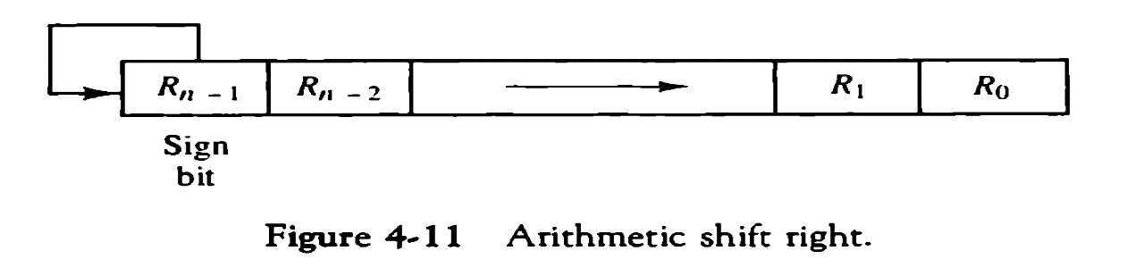
Shift Microoperations

Slide 17
Tools for Arithmetic Micro-operations
Binary Adder
Binary-Adder-Subtractor
Binary Incrementor
Arithmetic Circuit

Slide 18
Summary
Discussed about Addition and Subtraction.
Assessment Questions
Q1. How is Addition performed.
Q2. How is Subtraction performed.

Slide 19
THANK YOU

